Slide 1
Text Search Component in Med cam

Slide 2
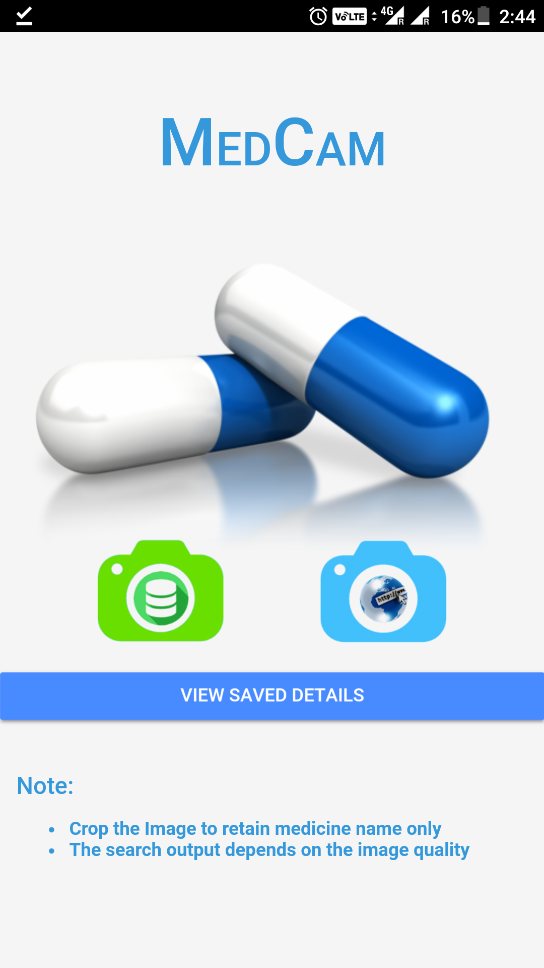
Text Detection

Slide 3
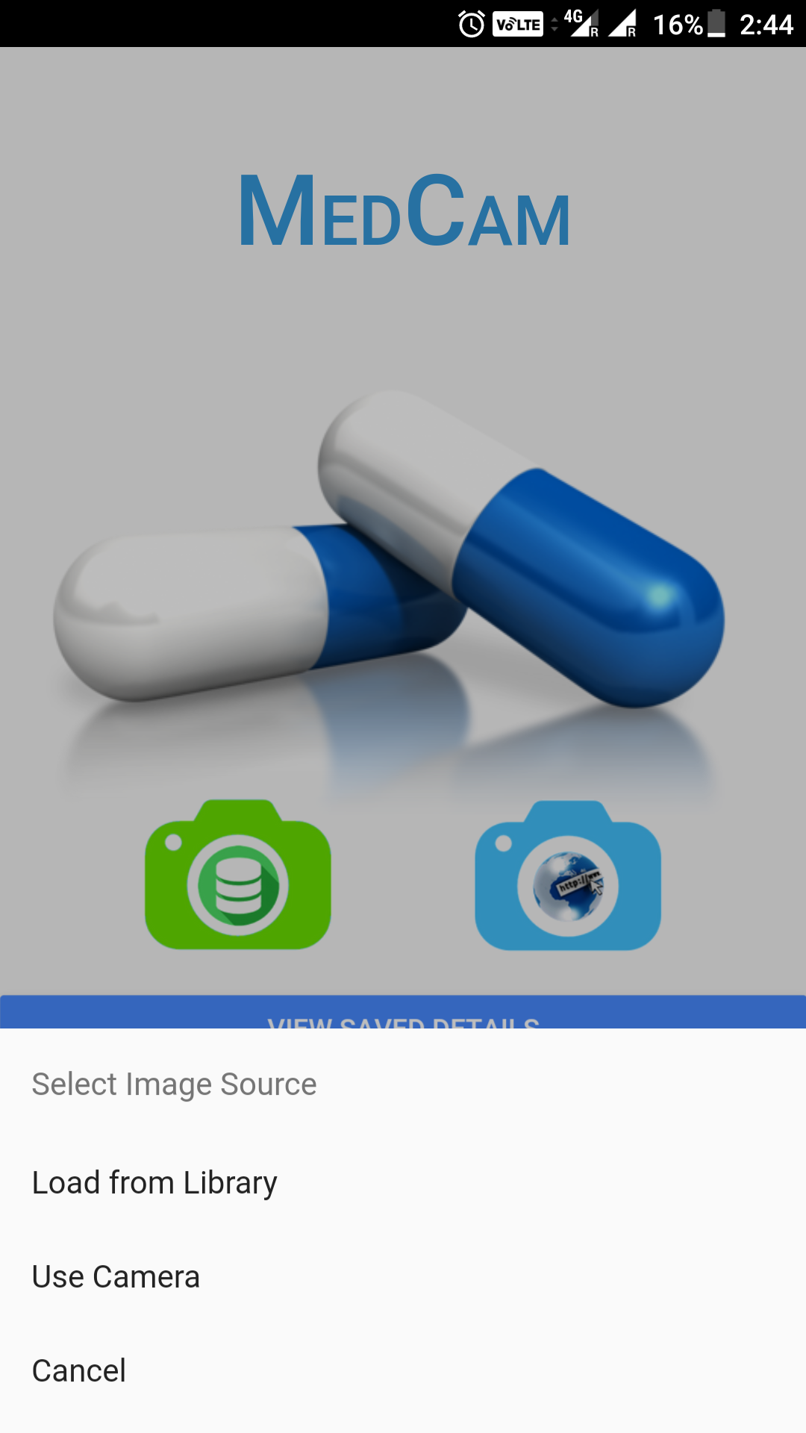

Slide 4
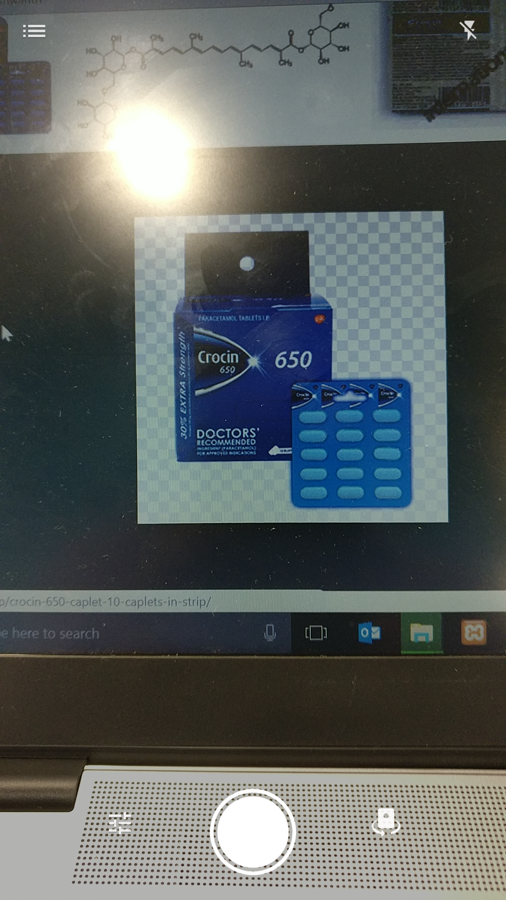

Slide 5
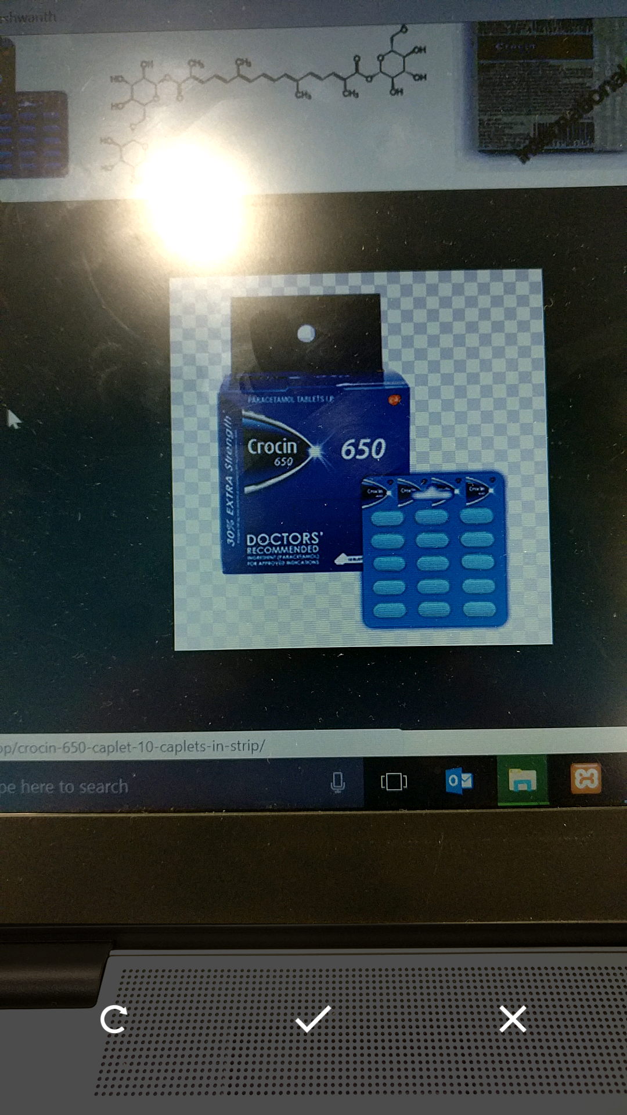

Slide 6
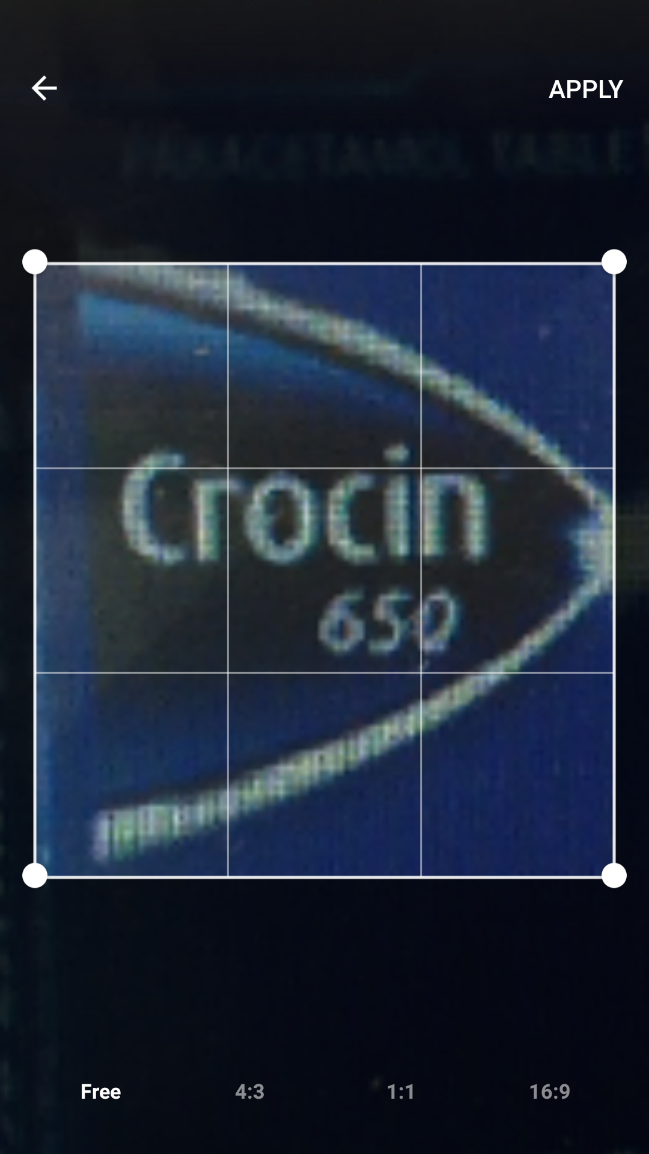

Slide 7
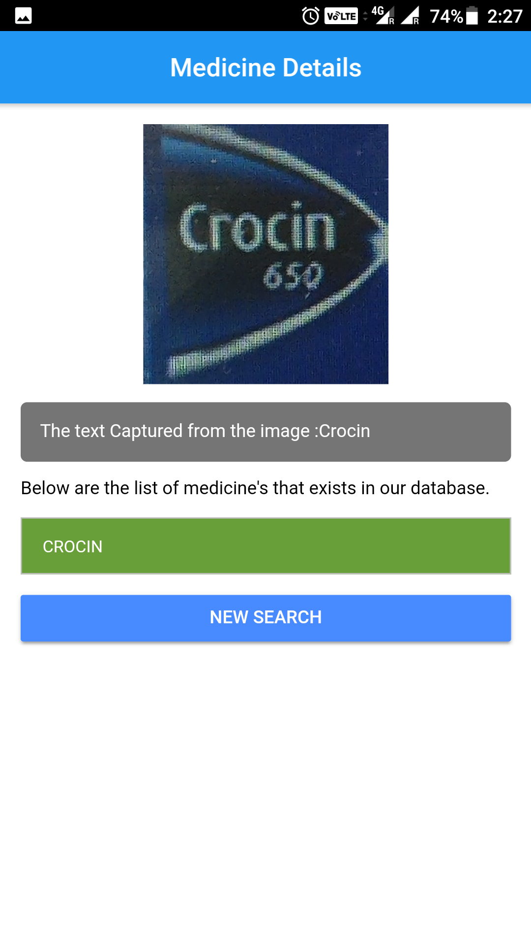

Slide 8
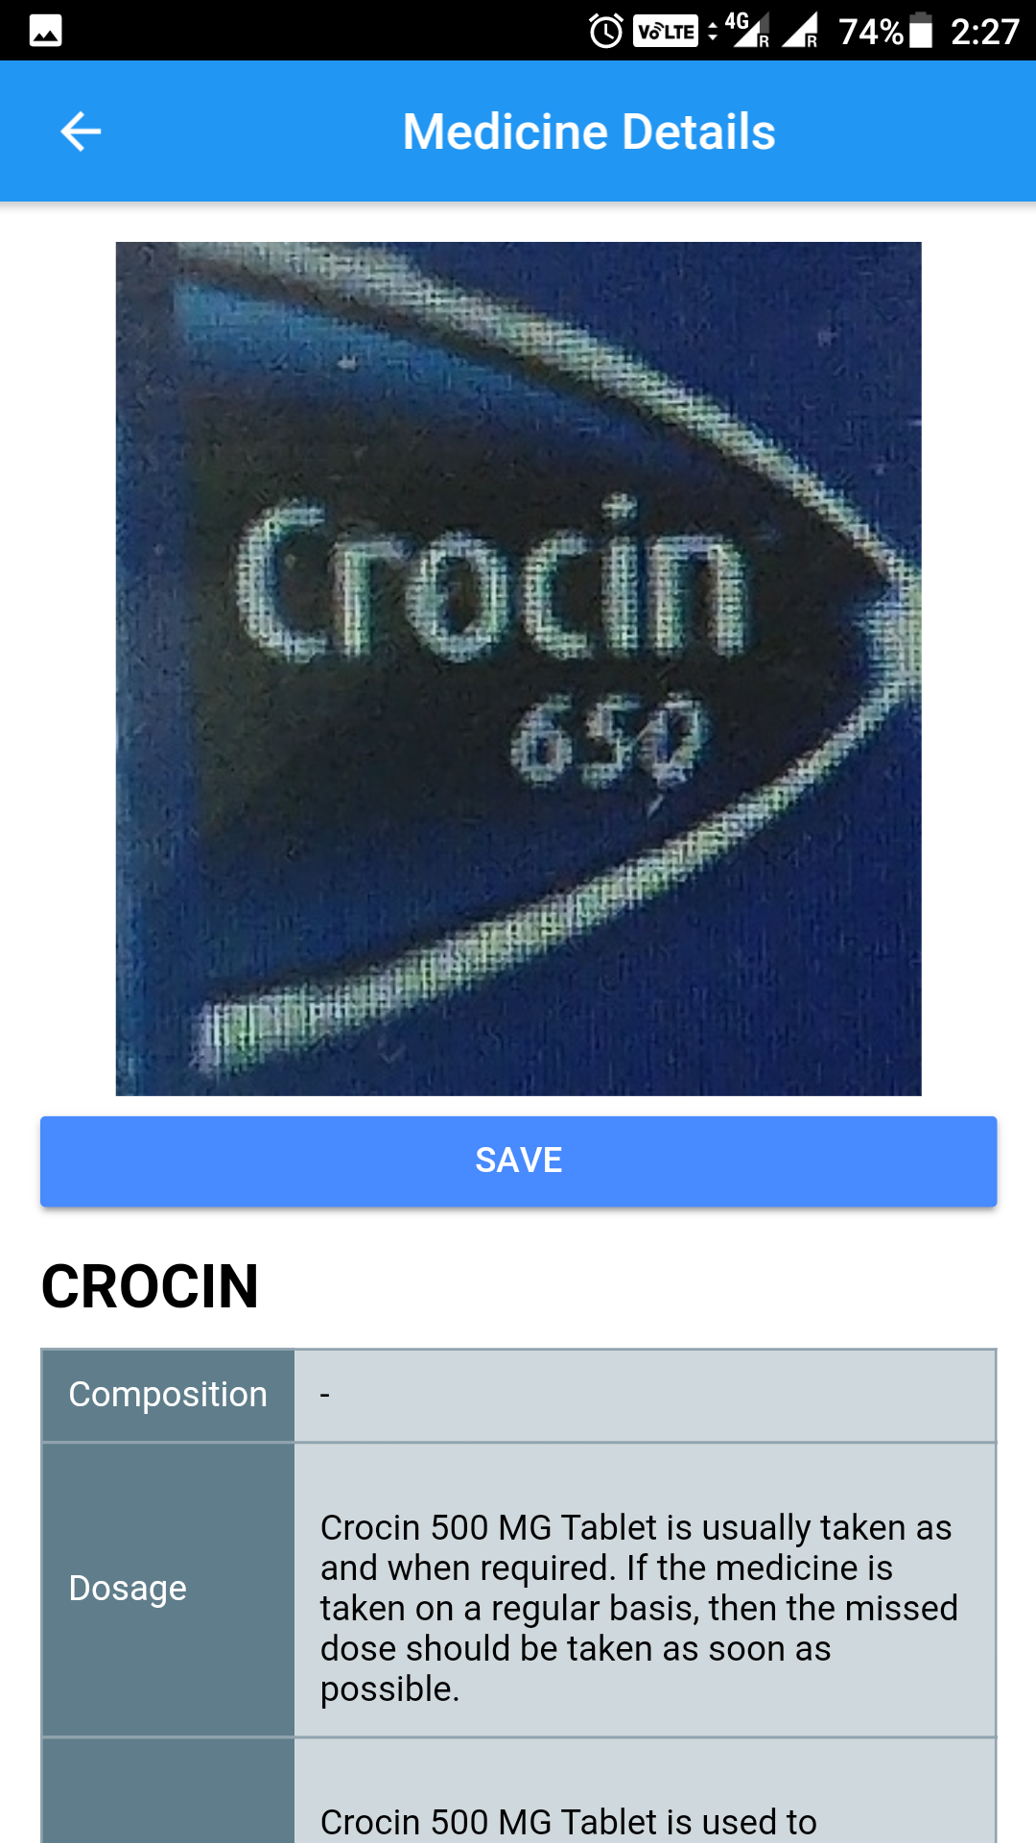

Slide 9
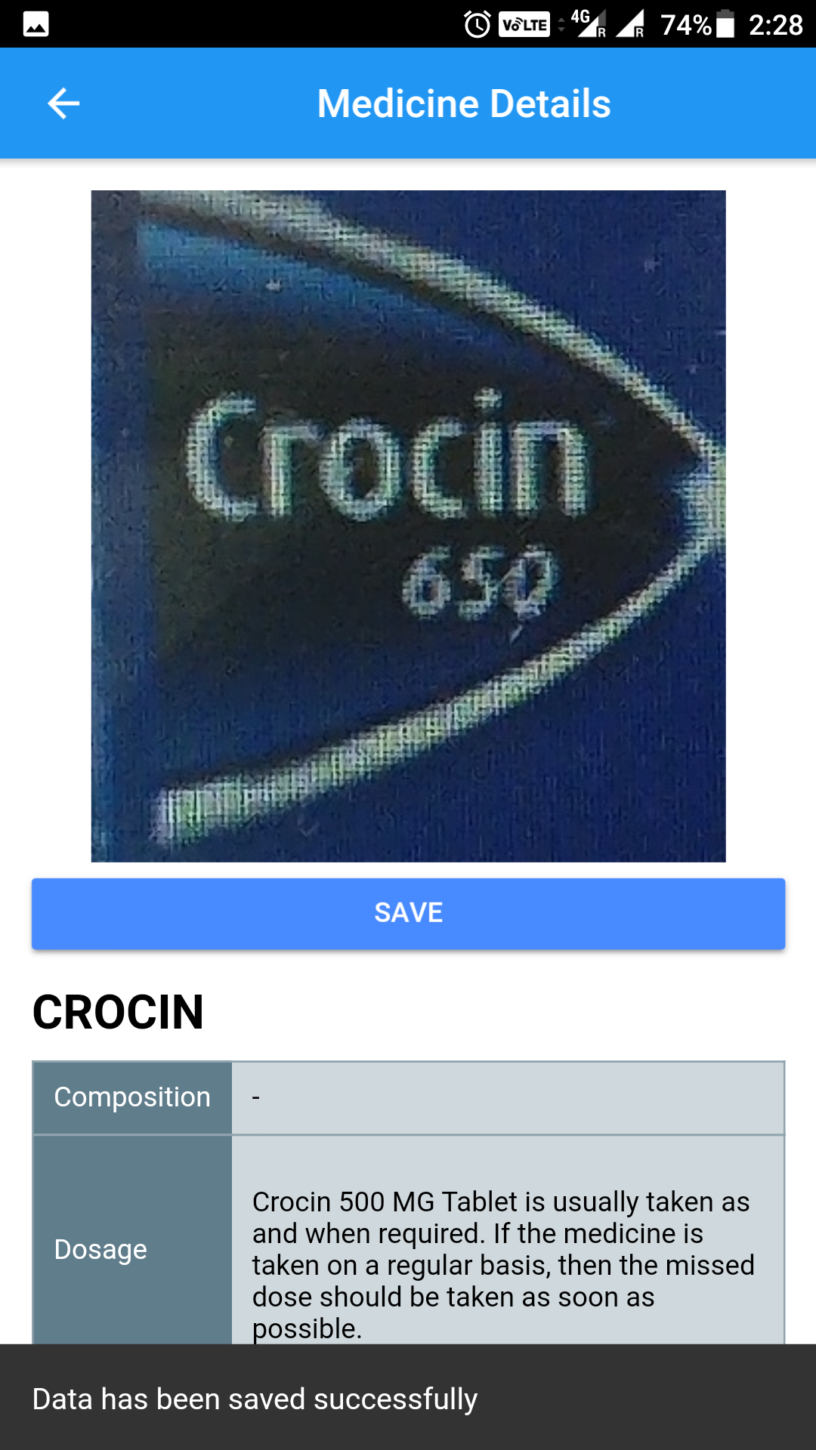
Click to save the result

Slide 10
Viewing and deleting the saved results.

Slide 11
Click to view the saved results

Slide 12
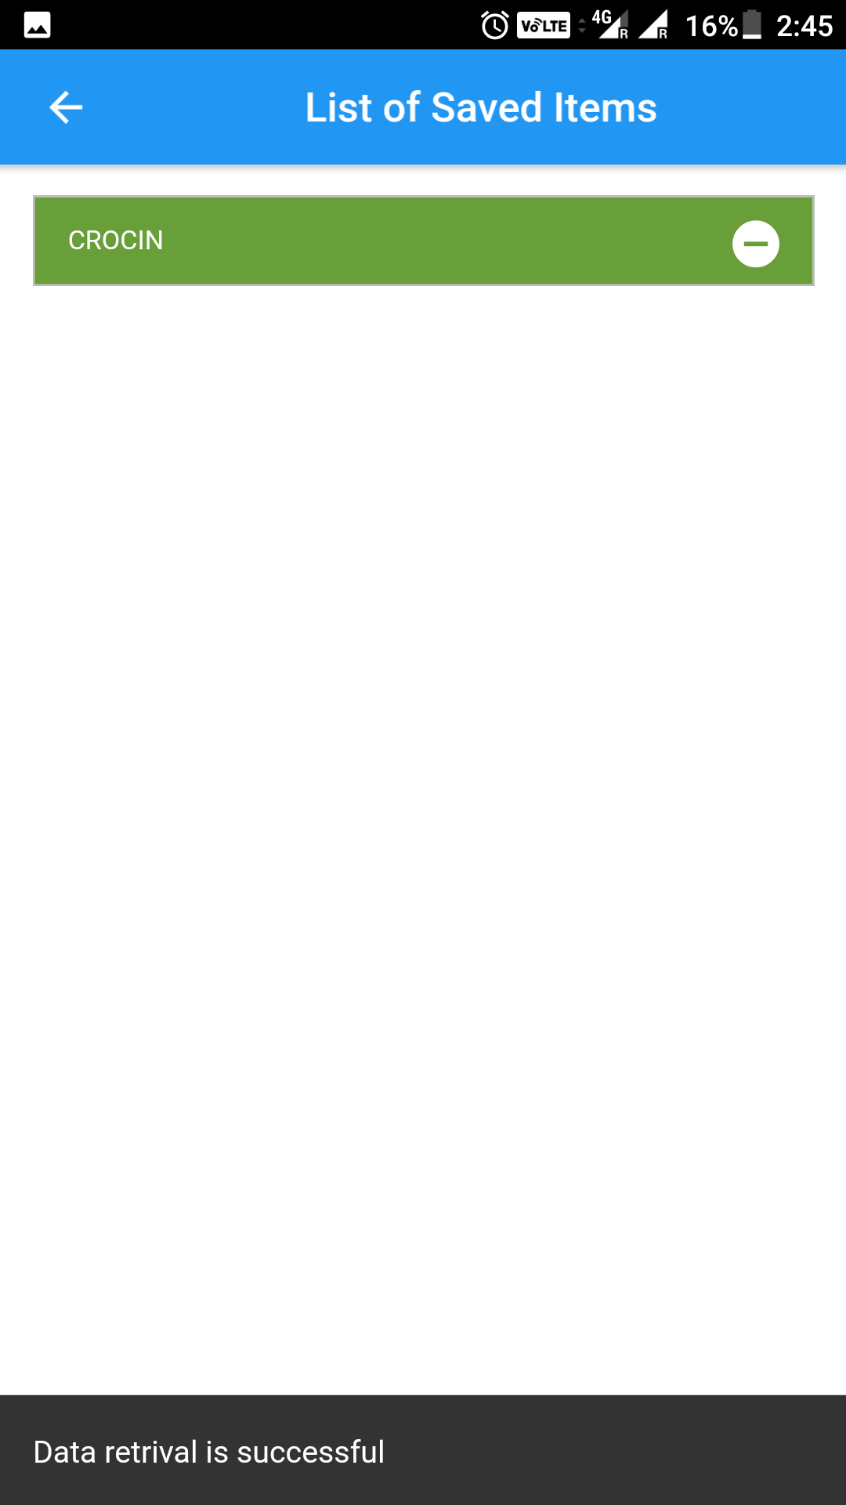
Click here to delete the record
Saved Results

Slide 13
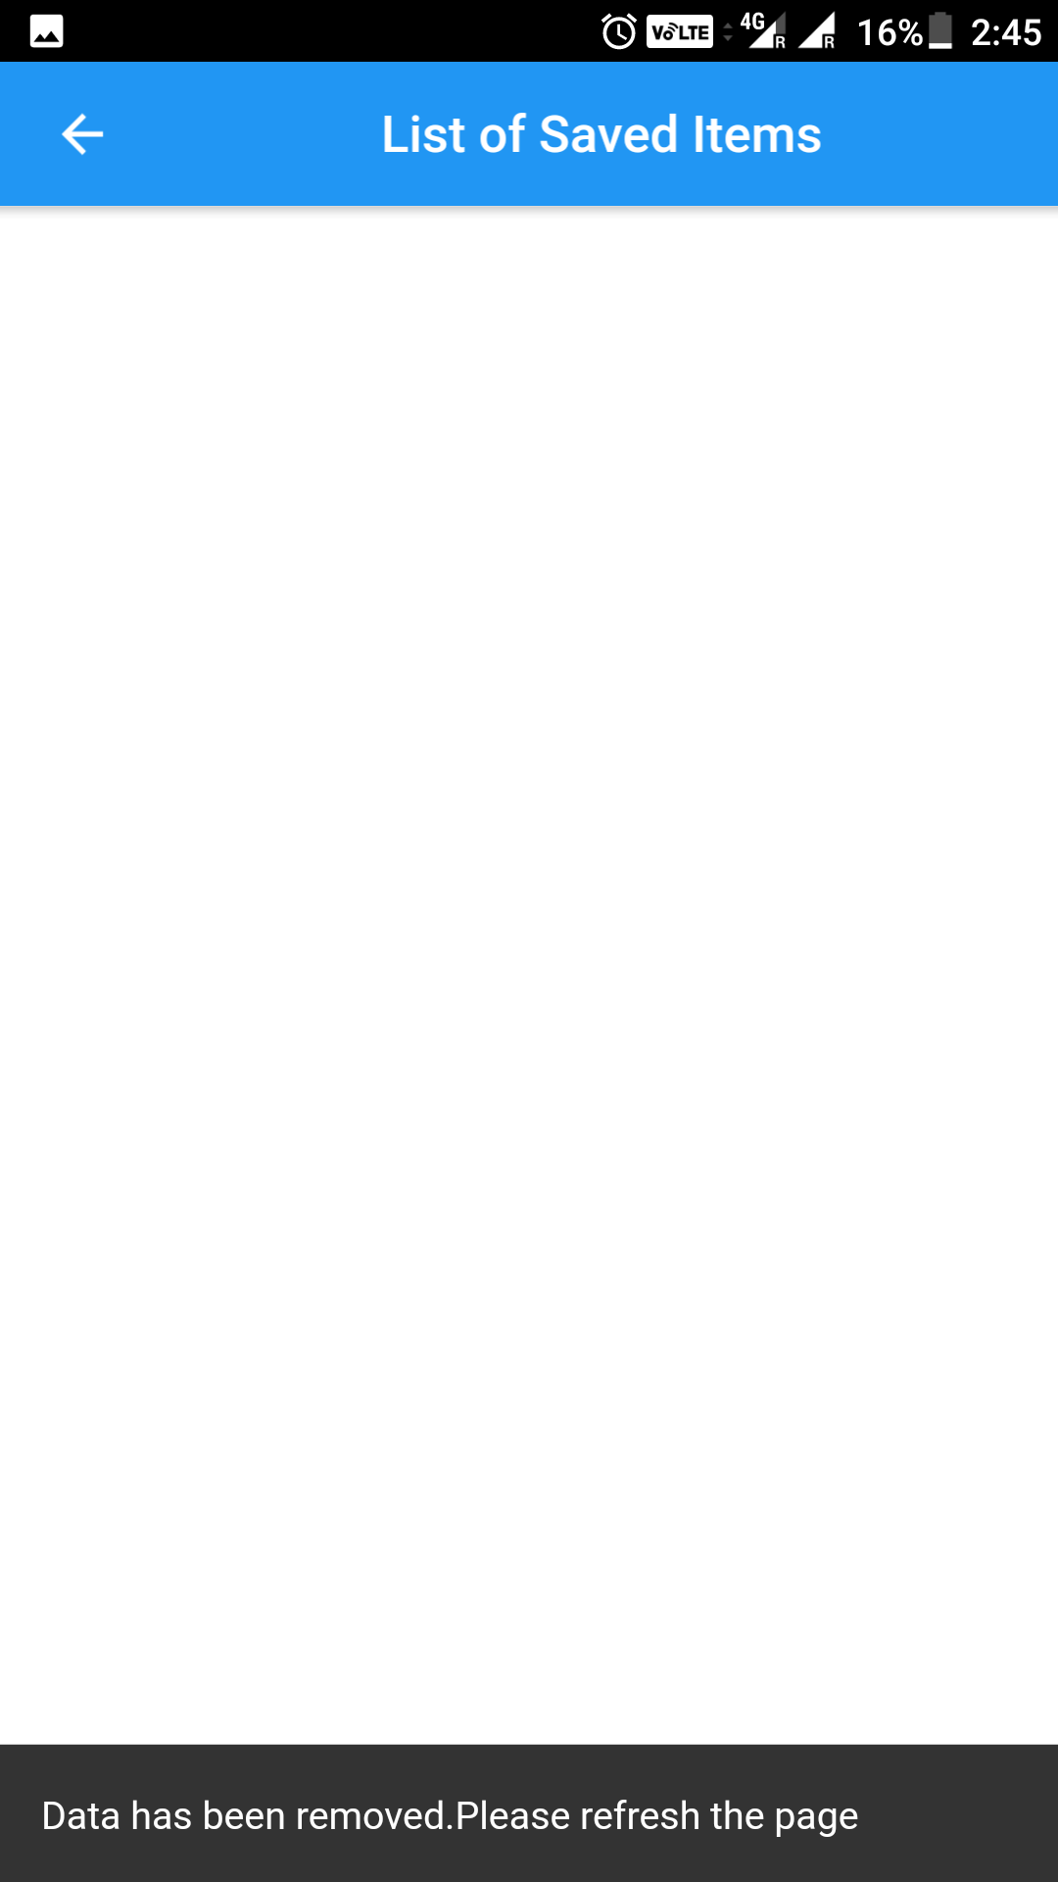
No records

Slide 14
Web Search Component in Med Cam.

Slide 15
Web Search

Slide 19
